Slide 1
Quantifying Tourist Behavior Patterns by Travel Motifs and Geo-Tagged Photos from Flickr
Liu Yang, Lun Wu , Yu Liu and Chaogui Kang
2018/01/12
Notes:
用Flickr上面带有地理标签的照片，挖掘旅游motif，基于motif理解并定量化旅游者行为模式。

Slide 2
Contents
Introduction
Constructing Travel Trajectory
Travel Motifs
Topological Travel Motif
Tourists’ Distinct Travel Patterns
Differentiating Natives and Tourists
Segmenting Individual Travel Journey
Temporal Travel Motif
Semantic Travel Motif
Motif-Based Clustering
Travel Network
Related Work
Flickr Photos
Motif

Slide 3
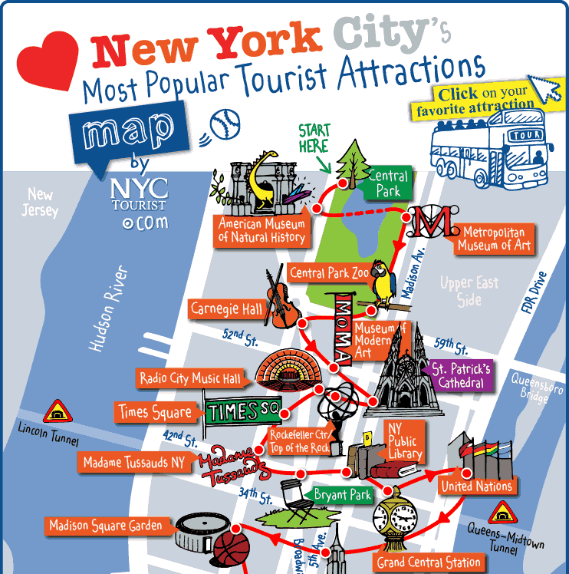
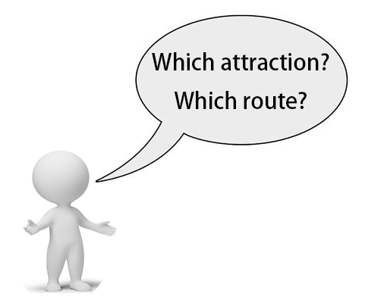
Introduction
Understanding Tourist Behavior Patterns
Research Field | Dataset | Researcher
Travel Patterns/ Travel Recommendation | Questionnaire | Lew A, Mckercher B et.al.
 | GPS Data | Zheng Yu et.al.
 | Flickr | Arase, Zheng Y-T, Sun et.al.
Notes:
首先是研究背景。我们在旅游时面临景点和路线选择的问题，旅游推荐也由此成为市场需求，旅游推荐的前提是从游客的旅游轨迹中，挖掘并理解游客的行为模式。为了获取旅游相关数据，最初学者们采用了调查问卷的形式，随着智能手机的出现，手机GPS定位数据被用来构建出行轨迹，但是调查问卷和GPS定位数据的获取难度都比较大。随着社交网络的兴起，人们在旅游时会在一些社交网站上分享旅游行程，比如FLICKR TWEETER、国内的微博等等，尤其是上传分享旅游照片。作为国外最热门的照片分享平台，Flickr上面存储了大量的旅游照片。下面先对Flickr数据做一个简单介绍

Slide 4
Introduction
Each Flickr photo/video record:
Field | Example
Photo/video identifier | 271905732
User NSID | 28998362@N00
User nickname | Pro-Zak
Date taken | 2006-10-08 11:15:57.0
Date uploaded | 1161054046
Capture device | NIKON+D70s
Title | Rockefeller+Rooftop+2
Description | Looking+across+the+rooftop+Anzac+Garden+on+top+of+the+British+Empire+Building%2C+Rockefeller+Center
User tags (comma-separated) | british+empire+building,manhattan,nyc,ohny,open+house+new+york,rockefeller+center,rooftop+garden,timothy+vogel
Machine tags (comma-separated)
Longitude | -73.977566
Latitude | 40.758505
Notes:
这里简单介绍一下FLICKR照片数据，每张照片或者视频是一条记录，这里列出了每条记录的主要字段，包括该照片或视频的ID、用户ID、用户昵称、拍摄时间、上传时间、标题、描述、用户标签、机器标签、经纬度。数据来自Yahoo Flickr Creative Commons 一亿条照片和视频记录。

Slide 5
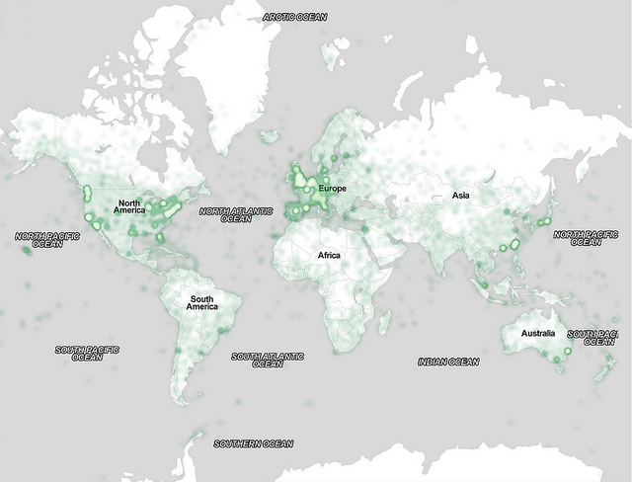
Introduction
https://code.flickr.net/2014/10/15/the-ins-and-outs-of-the-yahoo-flickr-100-million-creative-commons-dataset/
Notes:
为了更加直观的观察Flickr数据，这里引用 雅虎研究 的一张图片。Flickr 网站上面有超过1亿条记录，其中超过4800万的照片带有地理位置，取其中一百万图片做可视化，得到这张照片热度分布图。可以看出，活跃用户主要集中在欧洲、北美，纽约的记录数尤其多，因此呢，我的论文选取了用户活跃度高的纽约曼哈顿岛作为研究区域。这些带有地理位置的照片被广泛利用于构建游客轨迹，理解旅游行为。比如，Pladino 基于Flickr照片，对著名景点在当地和全球的吸引力进行定量化。Arase在城市间旅游的尺度上，定义了六个旅游主题，自然风光旅游、商业旅游等等。在更小的景点尺度上，也有旅游推荐方面的工作。比如，Lu et al 在考虑旅游时间和消费的基础上提供行程规划。Sun et al 构建了一个基于道路的推荐系统，推荐线路的基本单元是道路，他们对道路的旅游热度进行定量化，在推荐时不仅考虑道路的通行时间，还考虑了该道路的旅游价值。

Slide 6
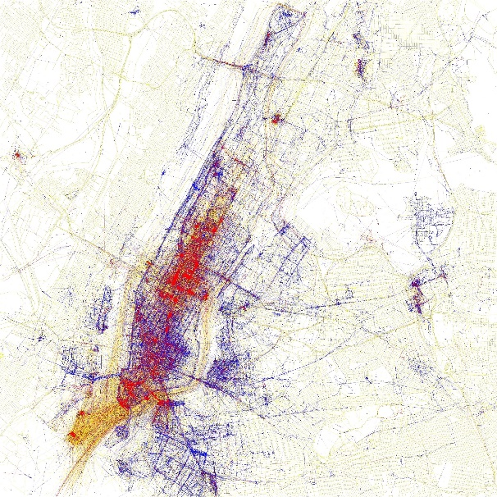
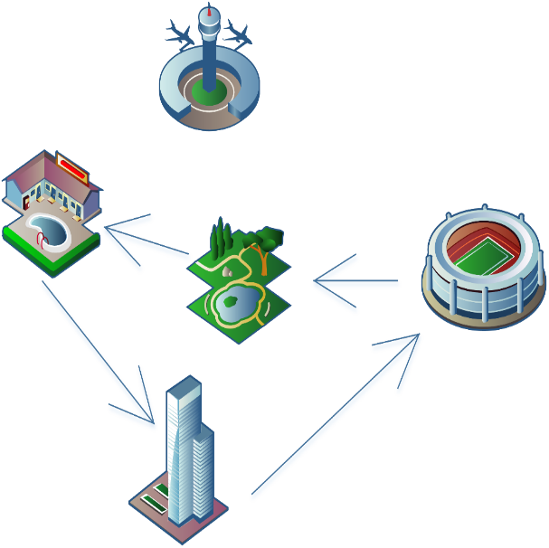
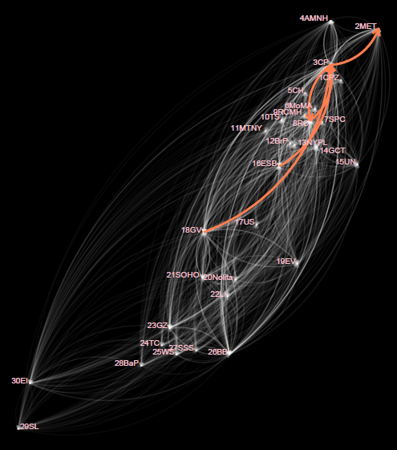
Introduction
Network Motif
Points
Trajectories
Network
Notes:
从模式挖掘的方法来看，传统方法一般基于Markov链或者协同过滤的方法，探测频繁出现的轨迹序列。而受到复杂网络研究的启发，我们发现，所谓的频繁轨迹序列可以类比为复杂网络中的motif。如果把景点当做节点，访问路径视作节点之间的边，那么游客的轨迹可以转化为一个有向图，所有游客的轨迹组合在一起构成一个复杂网络，流行的旅游序列则是该网络中的motif。

Slide 7
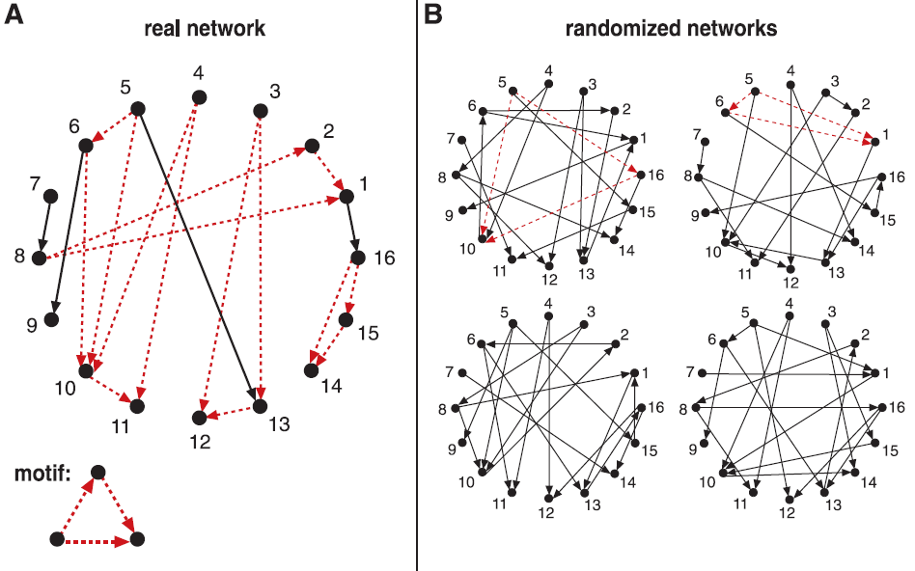


Introduction
Network motif
Motif:
A unit of decoration that is repeated all over something(as a fabric).
Milo, R. et.al. Network Motifs: Simple Building Blocks of Complex Networks. Science 2002, 298, 824–827.
Notes:
在解释network motif 之前，先解释一下motif这个词。韦氏词典对motif有一个解释是，在某个东西上重复的基本装饰单元。
类比一下，Network motifs 指网络中重复出现的子图。这个概念最早在2002年science上面的一篇论文被学者Milo等人提出，被定义为在真实网络中出现频率远远高于随机网络中出现频率的子图。他们发现，在生物化学、神经生物学、生态学及工程学多个领域都发现了类似的motif。当然，不同领域内motif不同，比如生态食物链构成的网络和互联网网络的motif是不一样的。这是拓扑方面的motif，关于motif的理论研究和应用也在不断发展。

Slide 8
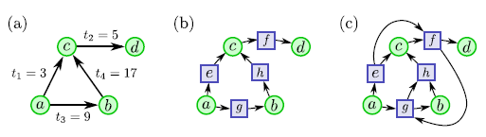
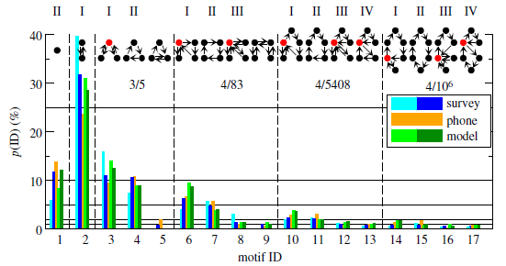
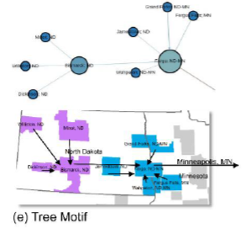
Introduction
 | Research Field | Researcher
Motif | Topological | Milo et.al.
 | Temporal | Kovanen et.al.
 | Topological | Schneider et.al Xi Liu et.al.
Kovanen et.al. Temporal Motifs in Time-Dependent Networks.
J. Stat. Mech. Theory Exp. 2011, 2011, P11005.
Xi Liu et.al.
Migrant Routing in the U.S. Urban System.
Schneider et.al. Unravelling Daily Human Mobility
Motifs. J. R. Soc. Interface 2013, 10, 20130246.
Notes:
先是有学者（Kovanen）引入了时间motif，并应用在打电话的研究上面。之后有人（Schneider ）把motif应用到人类日常移动性上的研究，还有我们实验室的刘曦师兄有一篇论文用motif做刻画美国城市间移民路线。受到以上工作的启发，我们想，在旅游网络中是否存在这样的motif，帮助刻画游客行为。而且，目前还没有工作分析语义层面的motif。所以，我的论文在拓扑和时间motif的基础上，增加语义层面的motif，从三个方面理解游客行为模式。

Slide 9
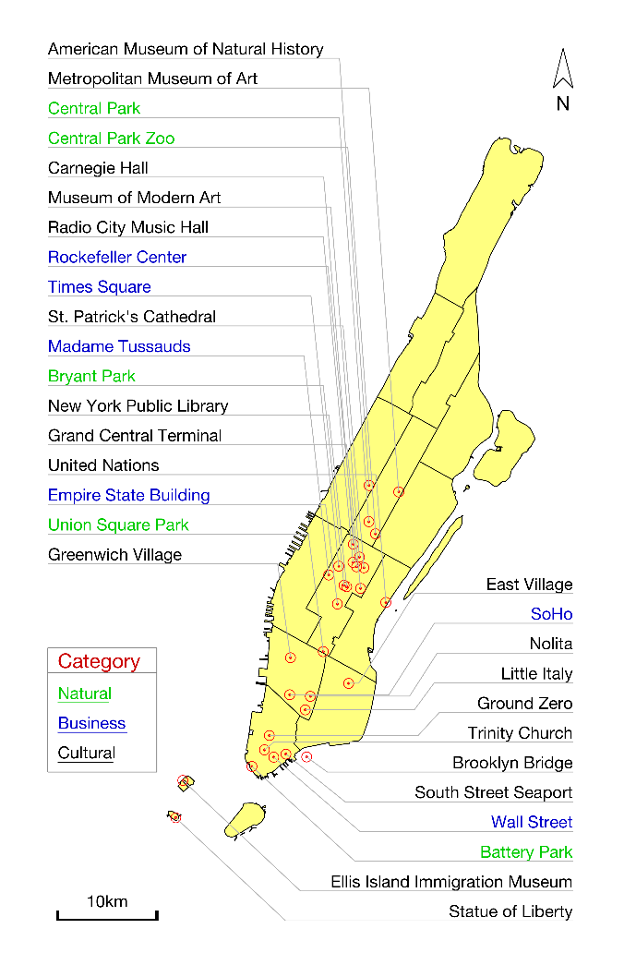





Travel Network —Constructing Travel Trajectory
A set of popular landmarks:
$$𝕃=\left\{l_{1},l_{2},…,l_{n}\right\}$$
$$l_{i}=\left(l_{i}.geom,l_{i}.type \right)$$
A set of travel points: (i.e., geo-tagged and time-stamped photos)
$$ℙ=\left\{p_{1},p_{2},…,p_{m}\right\}$$
$$p_{j}=\left(p_{j}.geom ,p_{j}.time\right)$$
A travel trajectory:
$$𝕋=\left\{\left(p_{1}.time,l_{1}.geom ,l_{1}.type\right),…,\left(p_{m}.time,l_{m}.geom ,l_{m}.type\right)\right\}$$
$$\left\|𝕋\right\|<m$$
Top 30 Landmarks in Manhattan.
Notes:
首先是构建访问点轨迹，给定n个景点和一个用户的m个访问点，这里的访问点即是照片所在位置，判断访问点是否落在景区内，计算得到访问点轨迹，每个访问点包括访问时间、访问的景区和对应景区的类型，景区类型按照常识划分为三类：文化类、自然类和商业类。本论文选取了曼哈顿最热门的30个景点，如左图，景点类型用名称颜色区分。这一步得到的轨迹包括当地人和游客，下面要把游客提取出来。

Slide 10
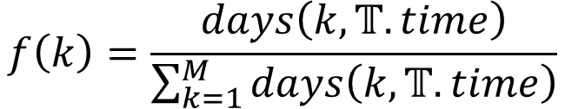
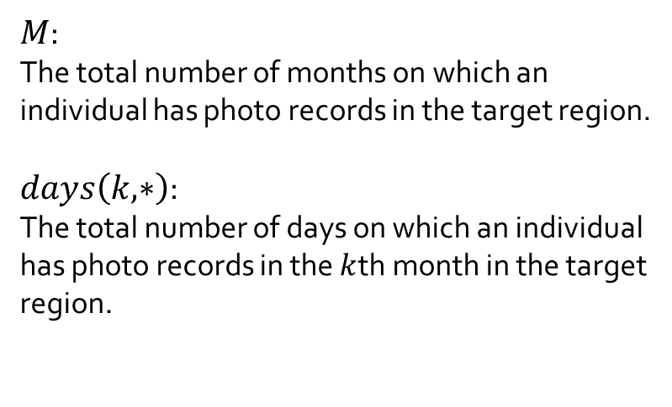
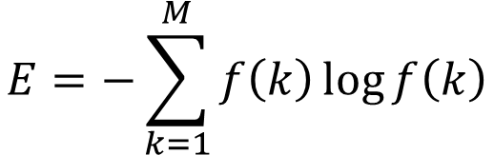
Travel Network —Differentiating Natives and Tourists
$$f\left(k\right)=\frac{days\left(k,𝕋.time\right)}{\sum_{k=1}^{M}{days\left(k,𝕋.time\right)}}$$
$M$:
The total number of months on which an individual has photo records in the target region.
$days\left(k,∗\right)$:
The total number of days on which an individual has photo records in the $k$th month in the target region.
$$E=−\sum_{k=1}^{M}{f\left(k\right)\log{f\left(k\right)}}$$
Notes:
一般来讲，游客访问景点的时间会在较短的时间段内，比如一周，旅游轨迹的时间跨度一般不超过一个月或者最多连续两个月，而当地人会在多个月份都有上传记录，当地人照片的时间相对于游客更加分散，所以对应的时间熵值也越高，于是可以采用熵值的高低来区分当地人和游客。

Slide 11
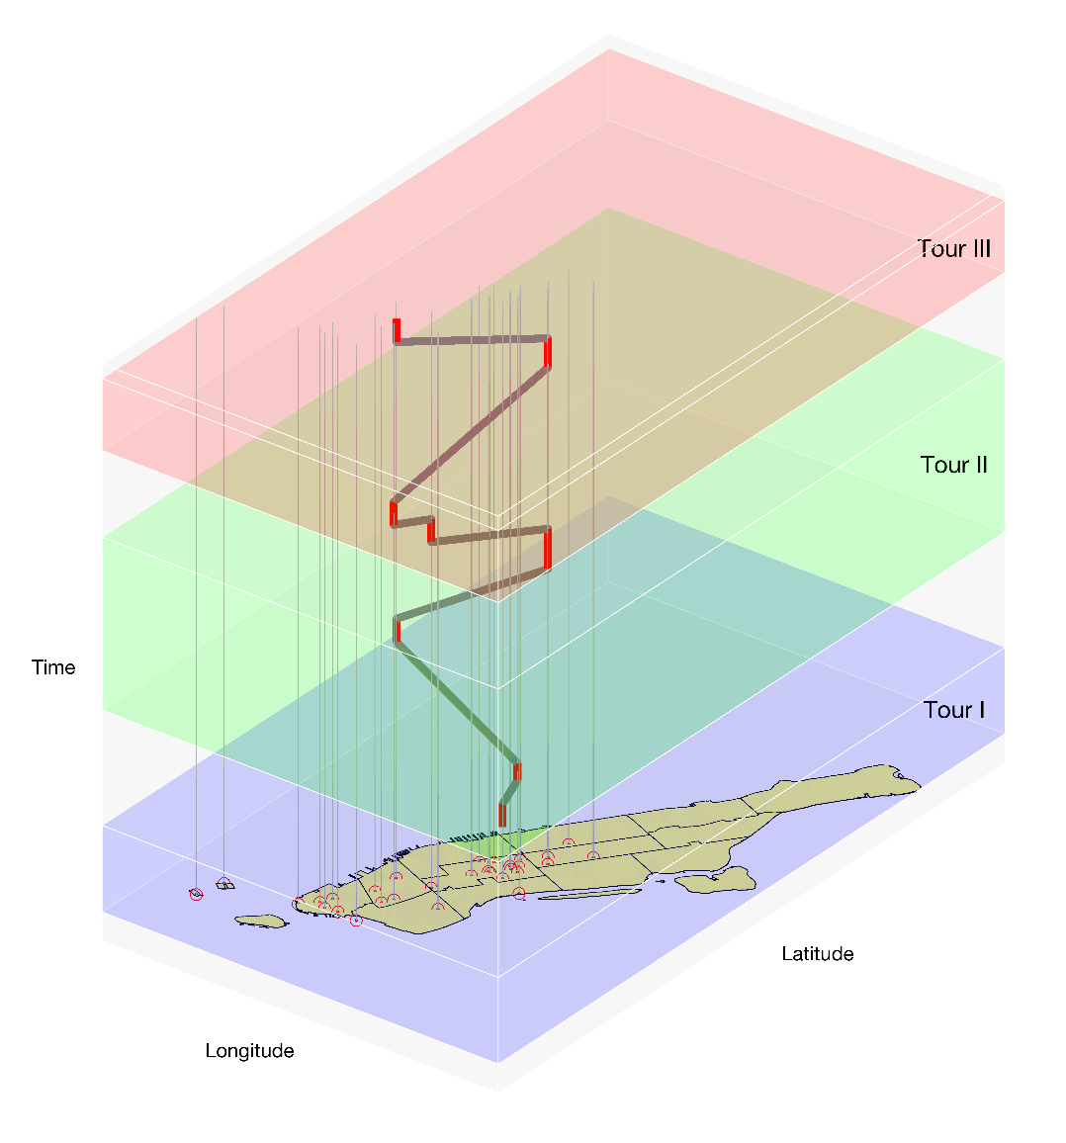
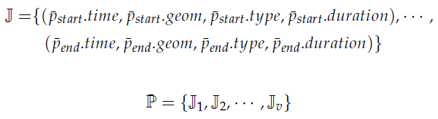

Travel Network —Segmenting Individual Travel Journey
$$𝕋=\begin{aligned}\{\left(p_{1}.time,l_{1}.geom ,l_{1}.type\right),…, \\ \left(p_{m}.time,l_{m}.geom ,l_{m}.type\right)\}\end{aligned}$$
An Examplar Travel Path with 3 journeys.
Notes:
游客提取出来之后，对轨迹做进一步处理。首先是把同一个景区内的访问点合并，得到该景点的停留时间，轨迹就简化为景区间访问路线。接着，如果相邻两个景区到达时间间隔超过某个阈值，认为前后是两次旅行。论文中时间间隔阈值超过5天。这样，游客的出游历史由多次旅行构成，如左图所示，蕴含了时间空间语义信息，

Slide 12
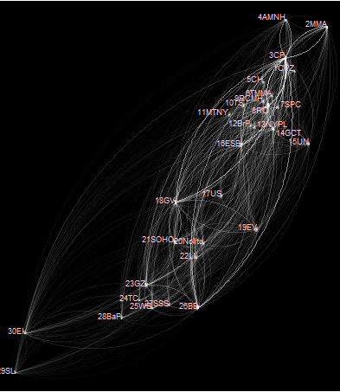
Travel Motif
Consecutive subsequence:
Discrete subsequence:
Travel Network
Notes:
接着挖掘旅行网络中motif，对motif的提取分为两种，连续抽取和间隔抽取。连续抽取保证子序列之间的点连续，间隔抽取保证访问点相对顺序不变，但不一定连续。两者意义不同。

Slide 13
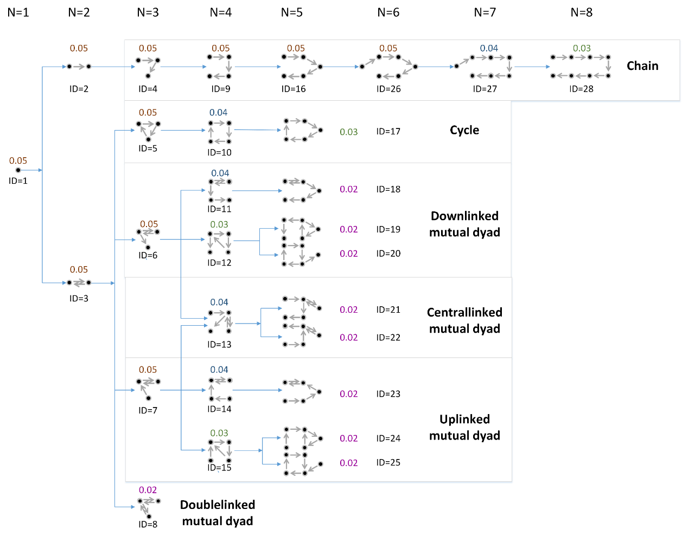
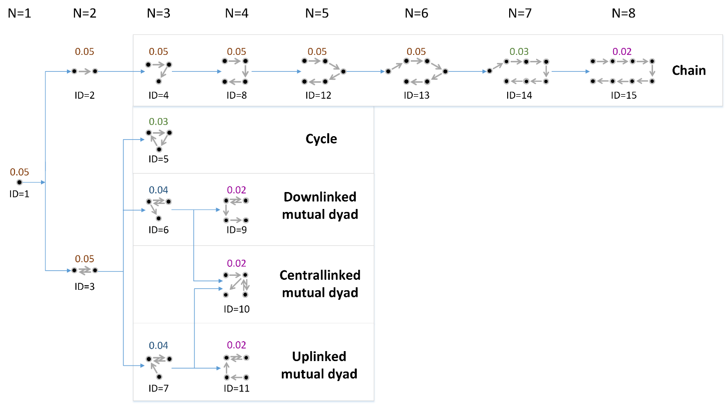
Travel Motif —Topological Travel Motif
Discrete Sequence
Consecutive Sequence
Dendrogram of Topological Travel Motifs
Notes:
首先是旅行的拓扑motif。图中N代表节点数目，旁边的小数对应该Motif出现的频率。频率指出现该motif的旅行数占总旅行数的比例。这里只对频率大于等于0.05即5%的motif进行分析。在这些motif中，节点数从1到6，即每次旅行95%的人参观景点不会超过6个，除了1个节点的motif，剩余的被分为5类，分别是CHAIN 链条型，CYCLE环形，DOWNLINKED MUTUAL DYAD 倒挂二元组，Centrallinked mutual dyad中心连接二元组型，uplinked mutual dyad牵挂二元组。CHAIN非常好理解，大多数人访问景点按照ABCD这样顺序访问，n个景点n-1条路线，不会重复。剩下的几个类型都是n个景点n条路线，存在重复访问的一个景点，这个重复访问的景点很像中心点。Downlinked mutual dyad指先出发去了某个景点，回到出发点后再顺序访问一系列景点，uplinked前挂型则是先顺序访问一系列景点，最后回到倒数第二个点即中心点，而中心型则是先顺序访问一系列景点，以中间某个点作为中心点，偏离中心点去访问一个景点后再回来顺序访问剩余景点。（住宿，不同时间景点活动不一样，）

Slide 14
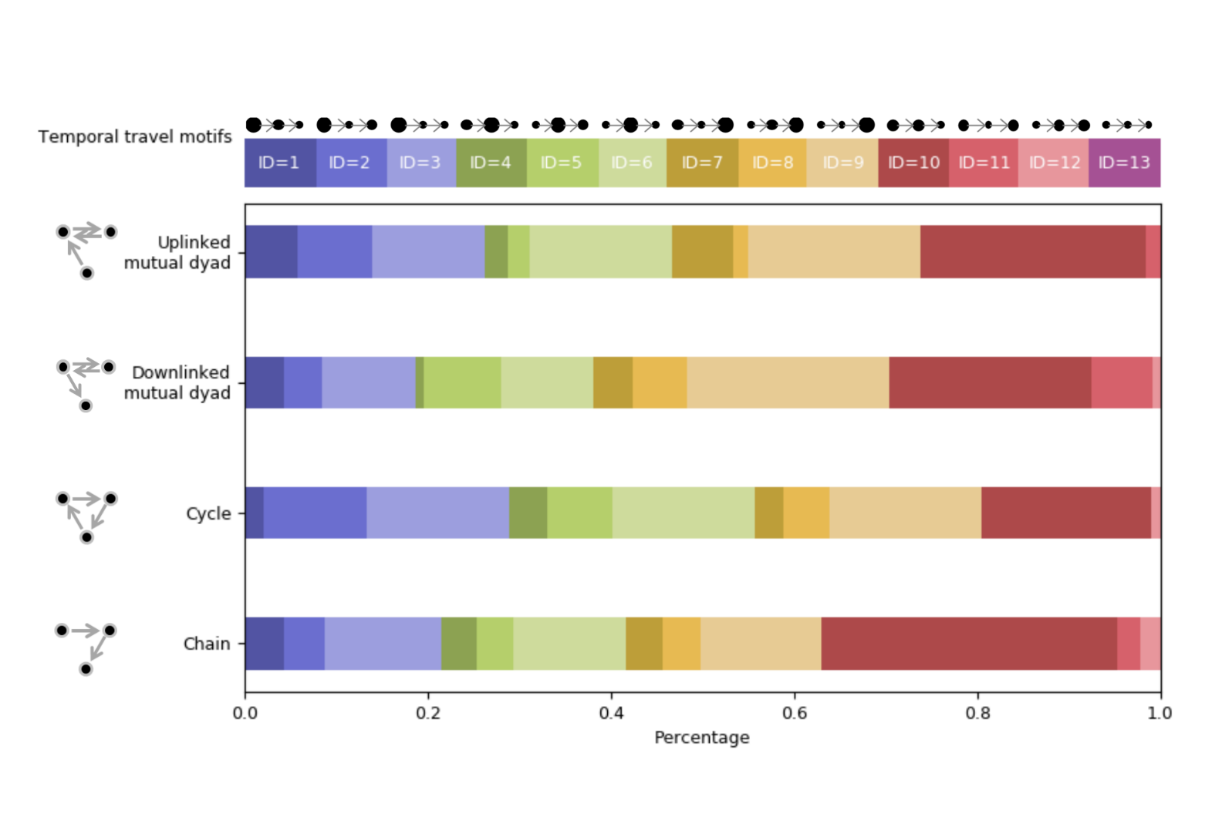
Travel Motif —Temporal Travel Motif
Consecutive Sequence
Statistical Characteristics of Temporal Travel Motifs
Notes:
接着在拓扑Motif的基础上进一步挖掘时间motif。对每一个拓扑motif，按照在结点停留时间长短的相互关系，定义了13个时间motif. 停留时间越长，对应结点的半径越大，蓝色、绿色、棕色分别表示在第一个结点、第二个结点、第三个结点停留时间最长，后面的颜色表示在时间上不存在明显偏好。，对Uplinked和downlinked比较，uplinked在第一个景点停留时间最长，downlinked在最后一个景点停留时间最长。Cycle和chain相对比较均匀，但cycle在三个节点上的区别更明显。这些行为的差异说明时间motif 可以用作区别游客的一个指标。

Slide 15
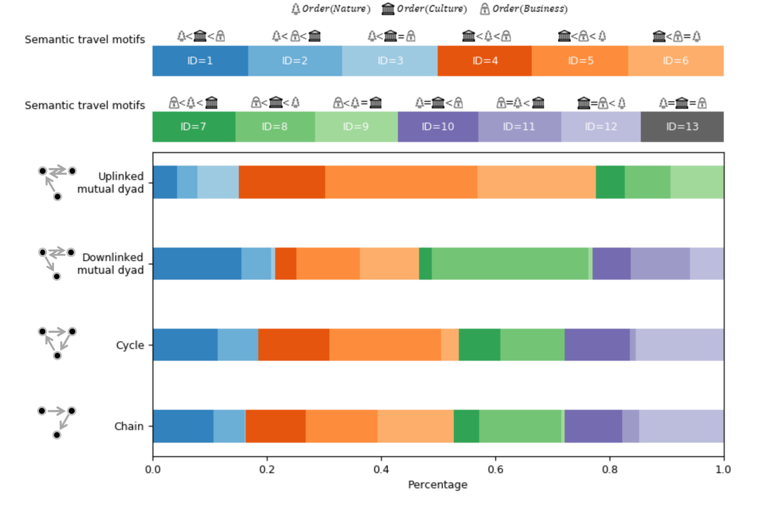
Travel Motif —Semantic Travel Motif
Consecutive Sequence.
Statistical Characteristics of Semantic Travel Motifs.
Notes:
最后从语义角度进行模式分析。所有景点被分成了自然、文化和商业三类，按照景点类别在轨迹中位序的大小关系挖掘了13个语义motif 。蓝色橙色绿色分别表示自然类、文化类、商业类景点为主导，后面颜色表示三类景点的偏好相似。很明显可以看出，对uplinked二元组，大部分游客偏好橙色模式，先访问文化类景点。对downlinked二元组，游客喜欢按照绿色模式中的商业类文化类自然类的顺序访问景点。cylce和chain有点相似，橙色模式即文化类景点稍占优势，但没有uplinked二元组那么明显。以上现象表明游客对不同景点类型的偏好是不同的。

Slide 16
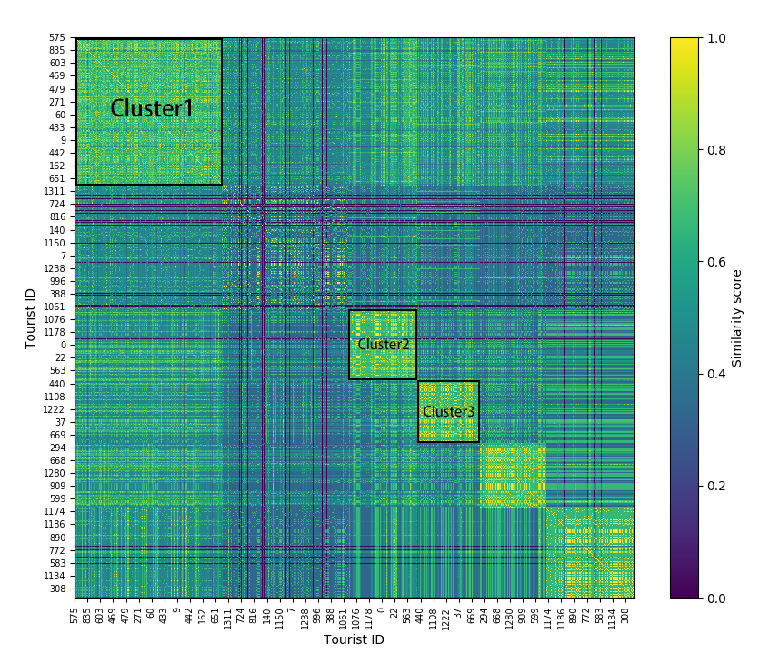


Tourists’ Distinct Travel Patterns
Consecutive Sequence Based Motifs
Travel Behavior Patterns of Distinct Tourist Groups
Notes:
前面分析表明游客访问景点时在拓扑、时间和语义上都有差异性，于是用三种motif构建向量来理解游客行为模式。，前面得到了lamda种拓扑motif，gama种时间motif和theta种语义motif，构建出一个长度lamda+gama+theta的向量，对每次旅行，它所属的motif，对应赋值为1，其余为0，如果一个游客有N次旅行，则对向量做平均得到每个游客的代表向量。然后用向量间余弦值刻画游客相似度。最后做层次聚类，得到右图，每一行或者每一列代表一个游客与其他游客相似度，从深蓝色到黄色表示相似度从0到最大1。
Cluster 1 contains tourists who like to stay in the first and second place for the similar duration.
Taking tourist 835 and 469 as examples, following ‘’chain” topological travel motifs with 3 and 8
places respectively, they both spent few time in the first and second places and more time in their
left visitations.
Cluster 2 represents tourists who prefer to visit ‘’natural” attractions firstly. Taking tourist 563 and
0 as examples, tourist 563 visited ‘’Central Park!Brooklyn Bridge!Rockefeller Center” and
tourist 0 visited ‘’Central Park ! Ground Zero ! Greenwich Village ! Empire State Building”.
They both take the ‘’natural” attraction ‘’Central Park” as the first target.
Cluster 3 stands for a group of tourists who are more interested in both ‘’cultural” and ‘’natural”
than ‘’business”. For example, tourist 37 follow a semantic travel motif ‘’cultural ! cultural
! natural ! natural ! cultural ! natural ! cultural”, without ‘’business” attraction visited.
Tourist 868 followed the semantic travel motif ‘’natural ! cultural ! business ! natural”,
who traveled to a ‘’business” attraction after ‘’cultural” and ‘’natural” attractions.

Slide 17
Discussion
Including textual information
Finer classification of attractions
Considering demographics of tourists
Notes:
(1) Including textual information. This study only utilizes the location and captured time of photos to derive tourists mobility patterns. However,
text data like tags and titles contain much information about trips. Therefore, future direction can take
text data into consideration for detecting additional contexts of trips, which are of great importance to
enrich the knowledge of tourist behaviors;
(2) Finer classification of attractions. This work classifies
landmarks into simply three categories, which are very rough. A finer classification of landmarks will
distinguish tourists better. For instance, two tourists sharing an interest in museums are more similar
than others who like to visit other cultural places, such as churches. Therefore, constructing a semantic
hierarchy with different granularities can be another direction of improvement to this research work;
(3) Considering demographics of tourists. People from different countries usually have different
preferences in many things, such as eating habits, styles of clothes, and genres of art, just to name
a few. Similarly, tourists with diverse cultural backgrounds are expected to behave different tourism
travel patterns. In this sense, by including the demographic background of tourists, we will be able to
deepen our understanding of tourist behavior patterns.

Slide 18
Q&A
Thanks for your attention！
Notes:
Serving as the prerequisite to travel recommender systems, detecting and visualizing tourists’
frequent travel patterns is of great importance for effective travel itinerary planning.
In summary, topological travel motif reveals typical travel patterns (e.g., popular/frequent travel
sequence) of tourists between a given number of tourism attractions; temporal travel motif indicates the time budgets (e.g., the staying duration) of tourists spent based on the order of visited attractions; and semantic travel motif differentiates the sightseeing tastes of tourists between different types
(e.g., natural, cultural, business and so on) of tourism attractions.
Our proposed analytic framework will enhance the state of the art tourism studies and
recommendation systems in three directions.
First, typical topological travel motifs enable tourists to determine the number of attractions to visit and the optimal route.
Second, typical temporal travel motifs further enable tourists to determine the visitation duration based on the order of attractions.
Third, typical semantic travel motifs enable tourist to determine which type of attraction to visit with high priority. More importantly, this kind of recommendation is different with the state of the art tourism studies and recommendation systems in that it requires no frequent travel sequence covering exactly the same attractions and travel routes. It therefore can remarkably enhance the flexibility of existing tourism recommendation systems to meet more general sightseeing preferences.

